Slide 1


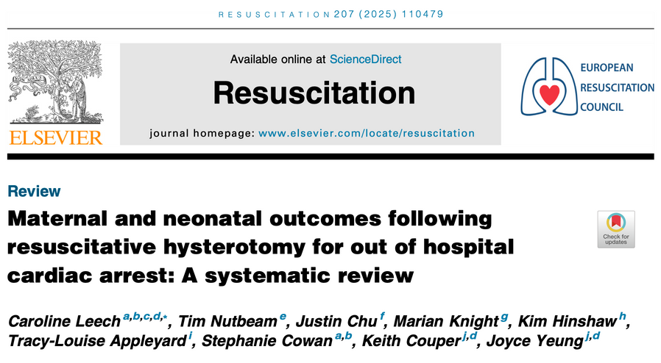
Summary
This study looked at maternal and neonatal survival rates following resuscitative hysterostomy, with some surprising results.
What They Did
This was a systematic review looking at maternal and neonatal outcomes following OHCA resuscitative hysterotomy
What They Found
27.3% (18/66) of resuscitative hysterotomies were performed in the prehospital setting and 72.7% (48/66) following arrival in hospital.
Median time from arrest to performing the procedure was 26.5 min
The Study
The Verdict
Leech C et al. Maternal and neonatal outcomes following resuscitative hysterotomy for out of hospital cardiac arrest: A systematic review. Resuscitation 207 (2025)110479
This study found a low maternal rate of survival(contrary to previous studies) from resuscitative hysterotomy and a higher rate of neonatal survival, even following prolonged resuscitation. Specific variables lead to increased neonatal survival.
Will this change your practice given the higher rate of neonatal survival? It will change mine, given that we will never have an RCT on this.

