Slide 1

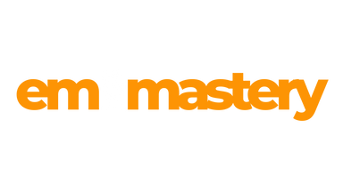
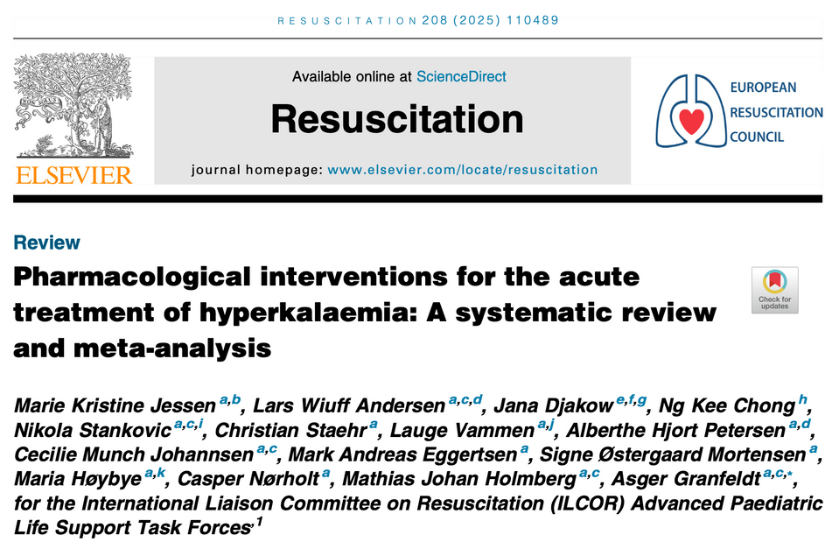
Summary
This was a review of acute pharmacological interventions, which included calcium chloride or calcium gluconate, bicarbonate, insulin/glucose frusemide and beta2 agonists.
What They Did
This systematic review and meta-analysis assessed the effects of acute pharmacological intervention for the treatment of patients with hyperkalaemia, with and without cardiac arrest. 101 articles were included.
What They Found
Insulin + glucose, beta2 agonists inhaled or IV reduced potassium of 0.7 to 1.2 mmol/l.
Bicarbonate did not really cause a change in potassium levels
No evidence was found for a clinical benefit of calcium.
The Study
The Verdict
Jessen K.K et al. Pharmacological interventions for the acute treatment of hyperkalaemia: A systematic review and meta-analysis.Resuscitation 208 (2015) 110489.
We need to beware of interpreting the results in this meta-analysis. It included human and animal studies and made assumptions on the comparability of studies. The studies were small and they challenge what we sometimes clinically see.

